Slide 1
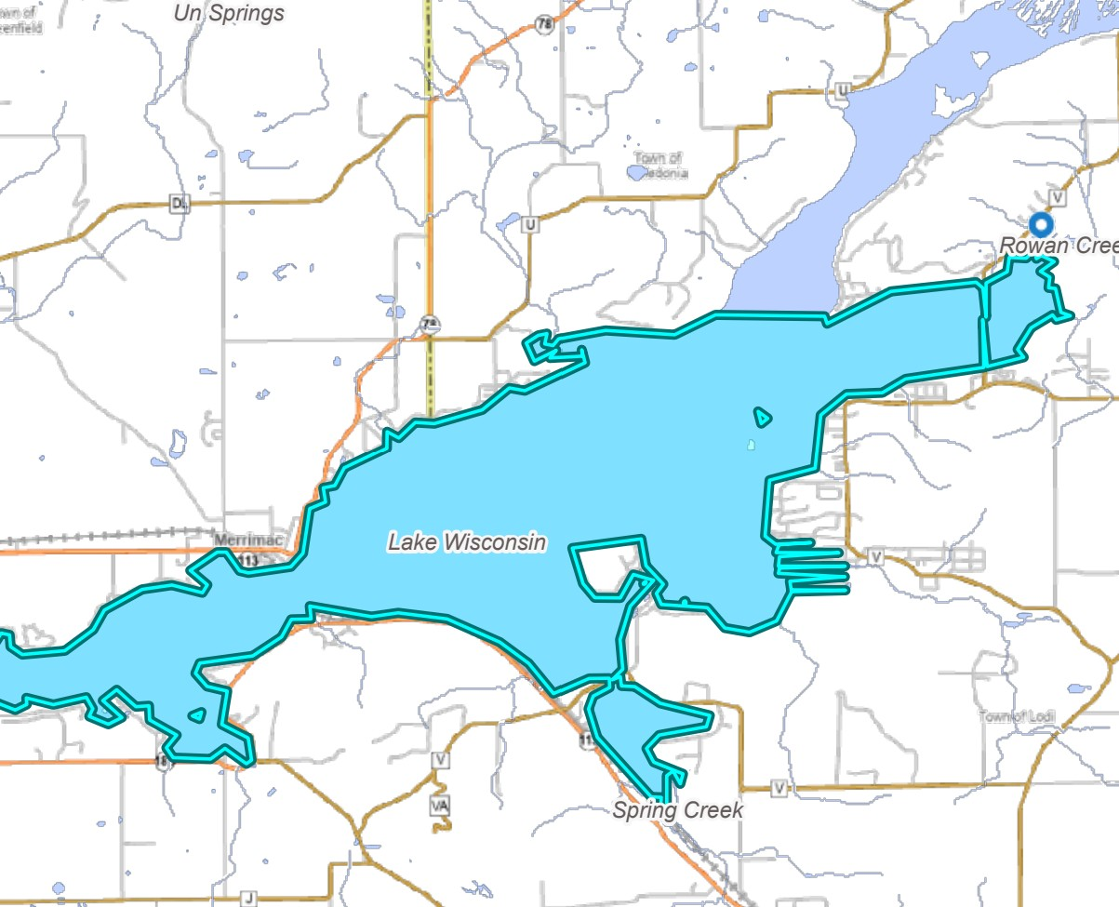

Lake Wisconsin Alliance 2024-2025
Highlights

Slide 2
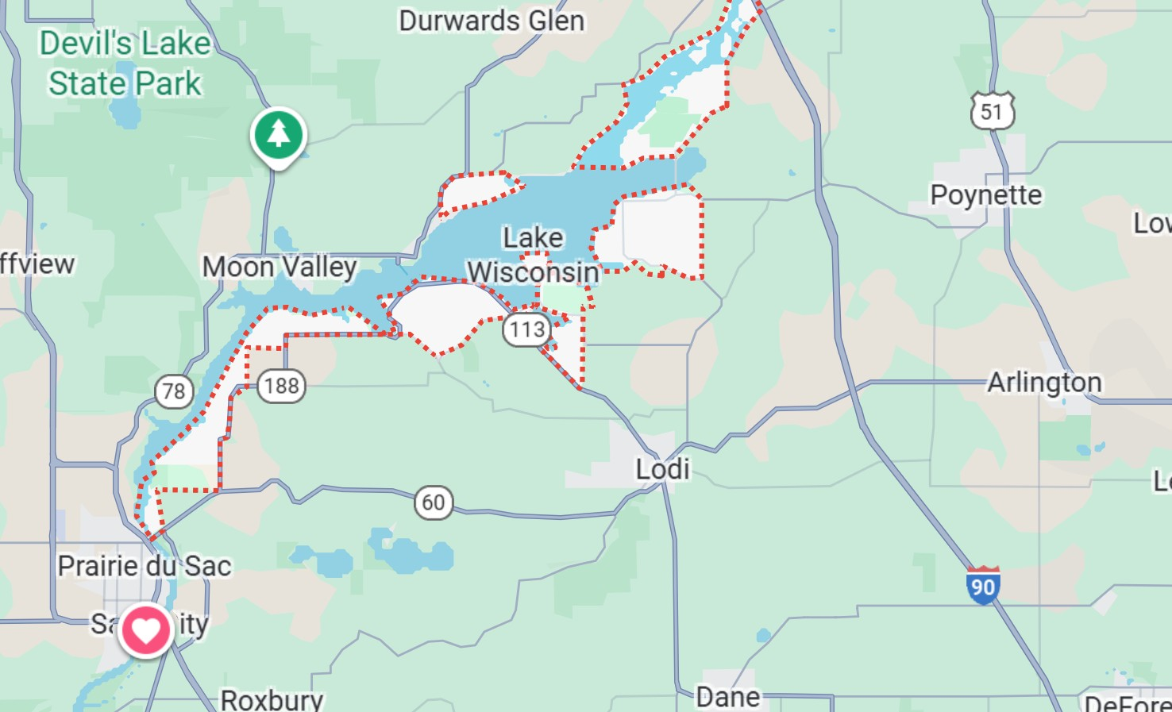
This year was the second year that Lake Wisconsin Alliance gathered as many as would come from the watershed of Lake Wisconsin. It was a good meeting with 15 different organizations coming together to learn how we can all cooperate and help Lake Wisconsin.

Slide 3
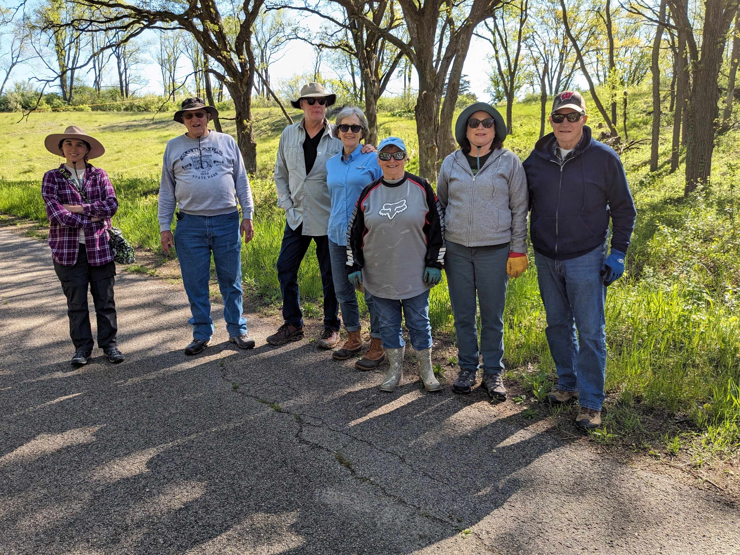
Exploring the Lake Wisconsin Watershed Series
We went to the Sauk Prairie Recreation Area (part of the old Badger Army Ammunitions Plant) to pull Garlic Mustard. It is an invasive species and is only gotten rid of by pulling it out of the ground. It is a pretty yellow flower but it takes over the land.

Slide 4
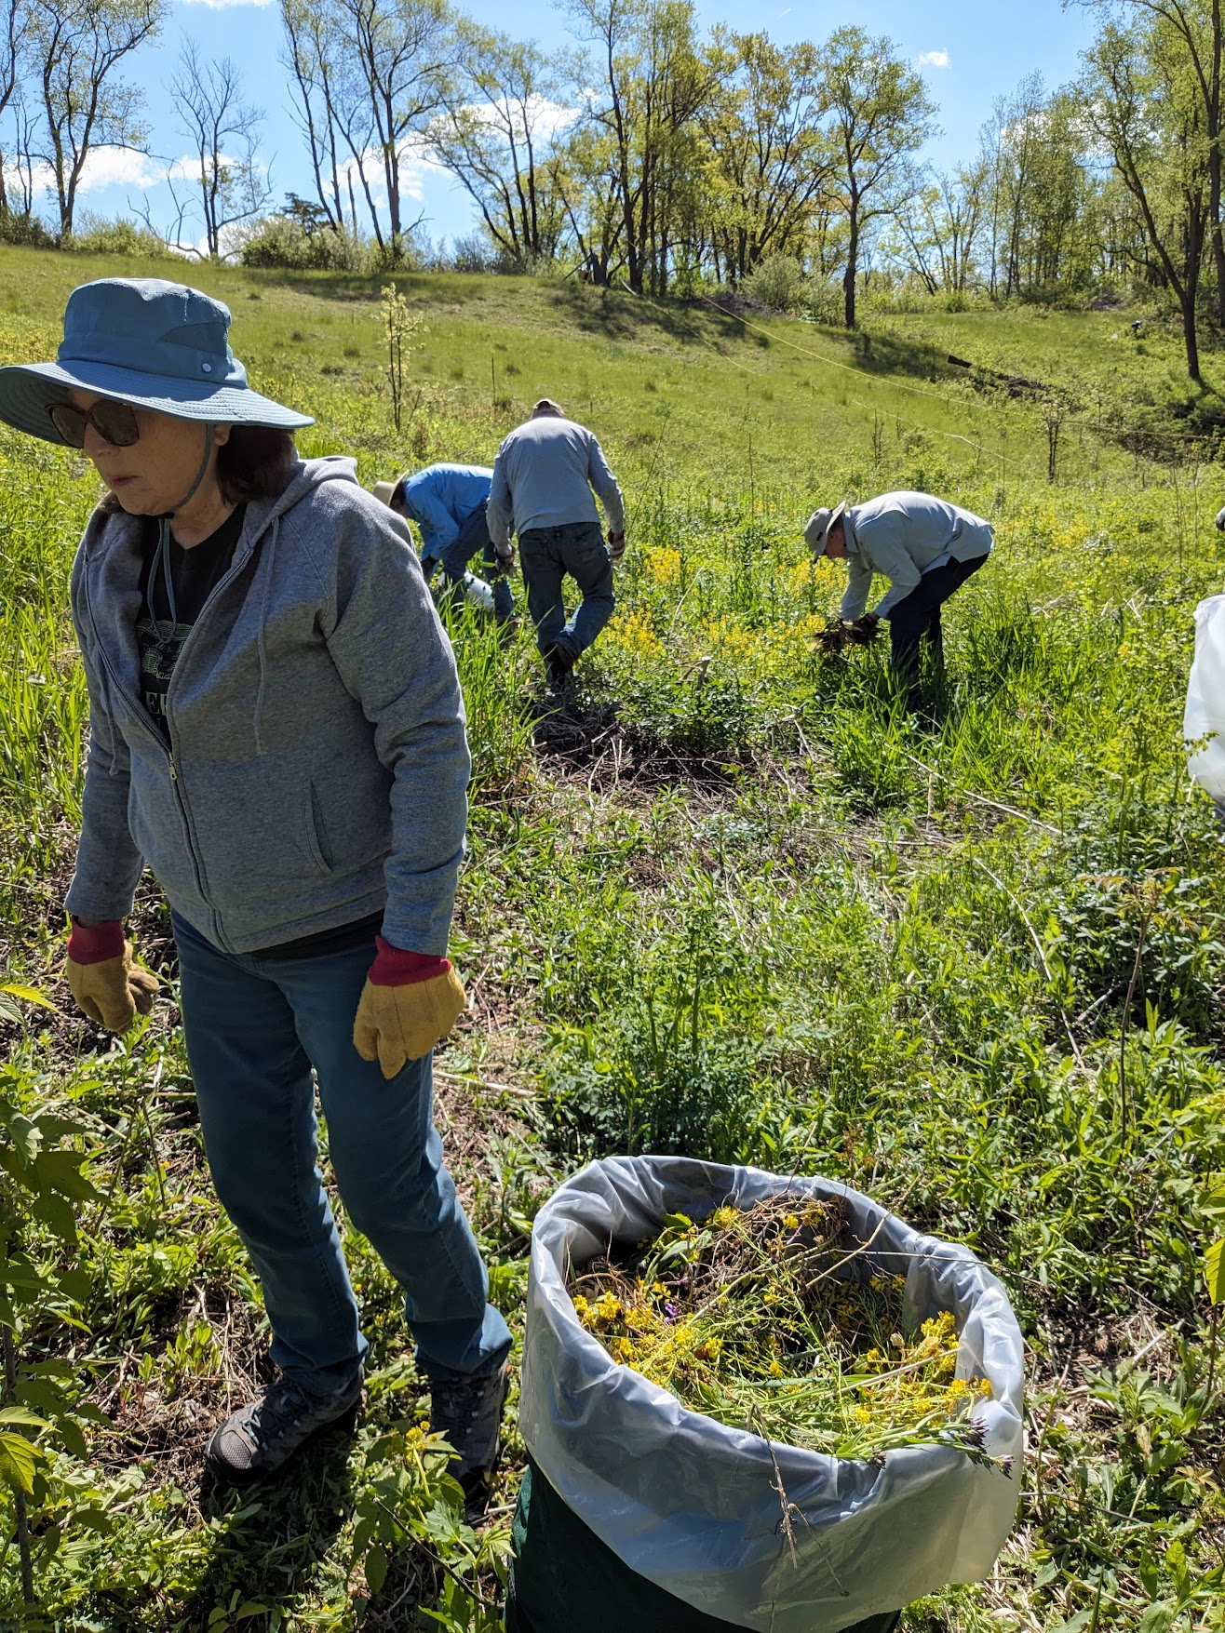
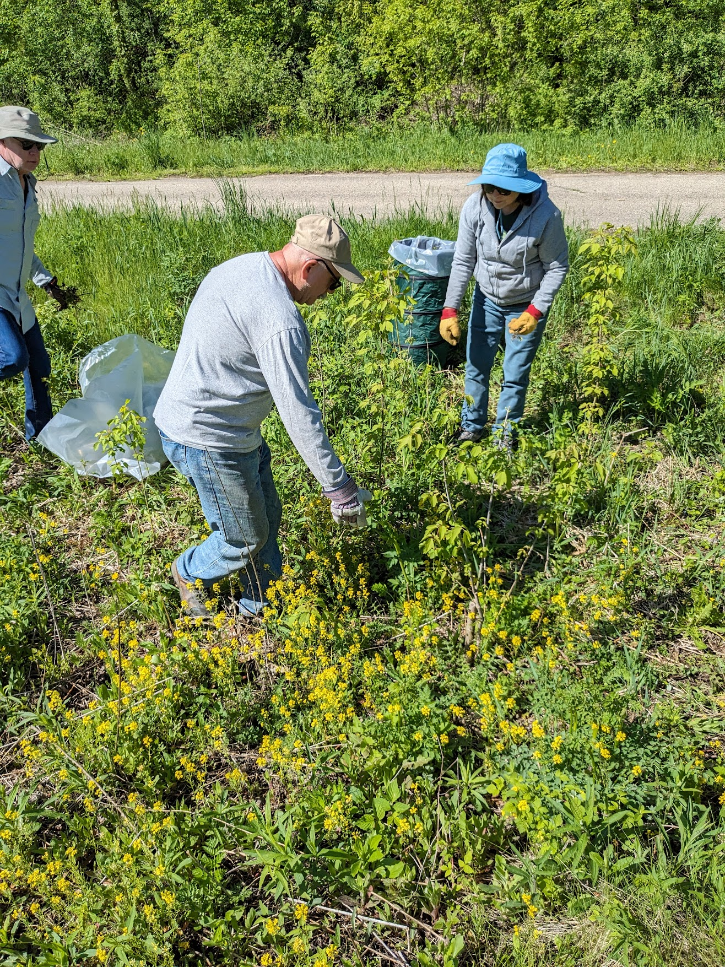

Slide 5
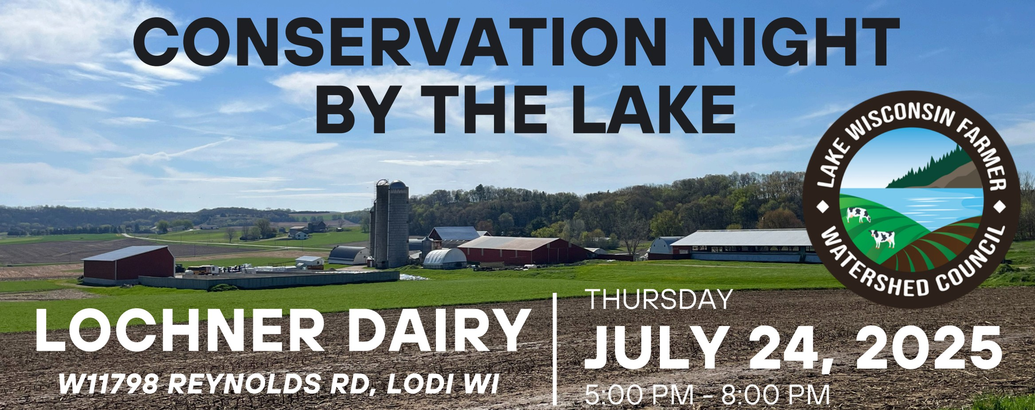
Conservation Night by the Lake
This event is sponsored by the Lake Wisconsin Farmer Watershed Council. Lake Wisconsin Alliance is a contributing sponsor. This event is a showcase of sustainable farming practices that protect Lake Wisconsin.

Slide 6
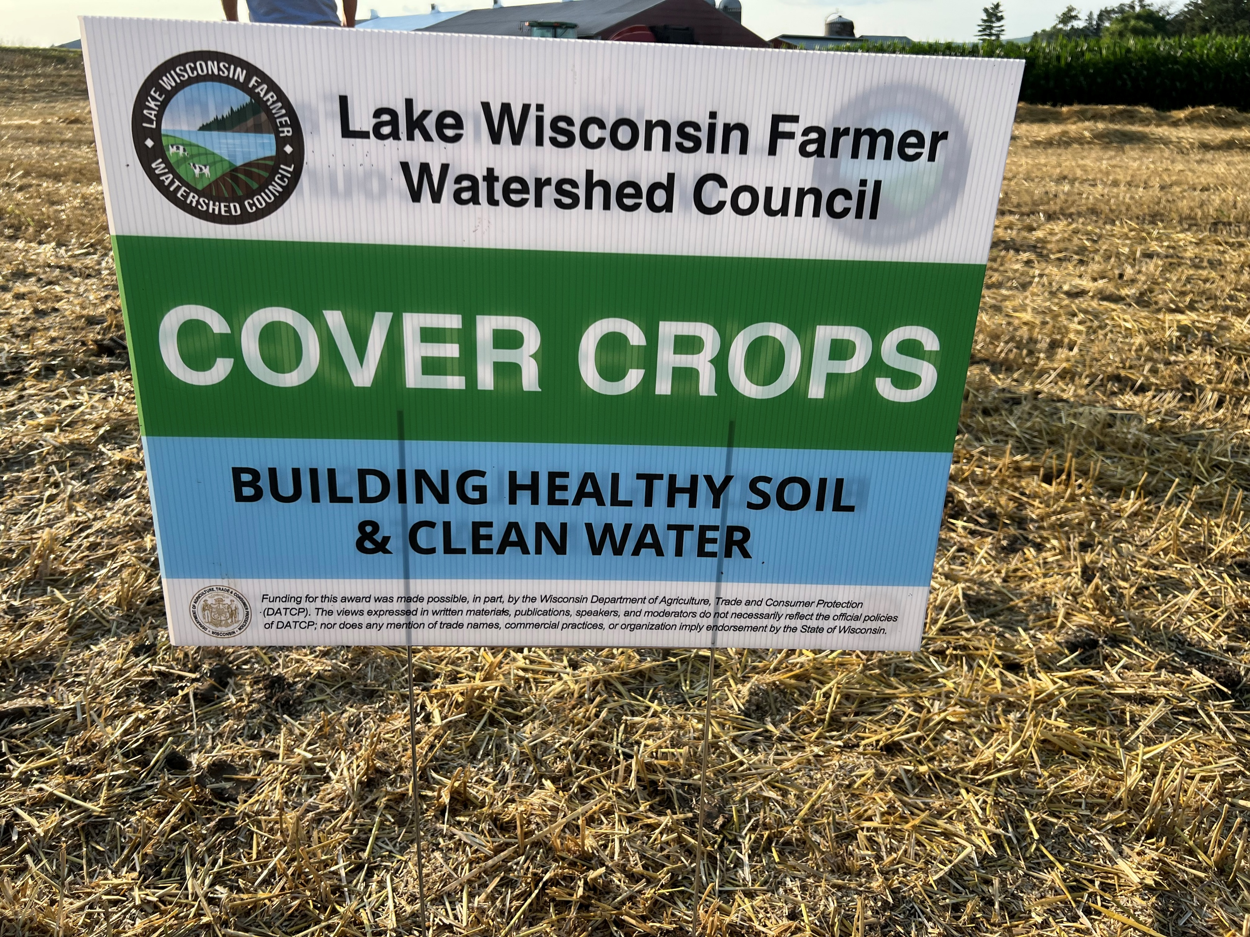
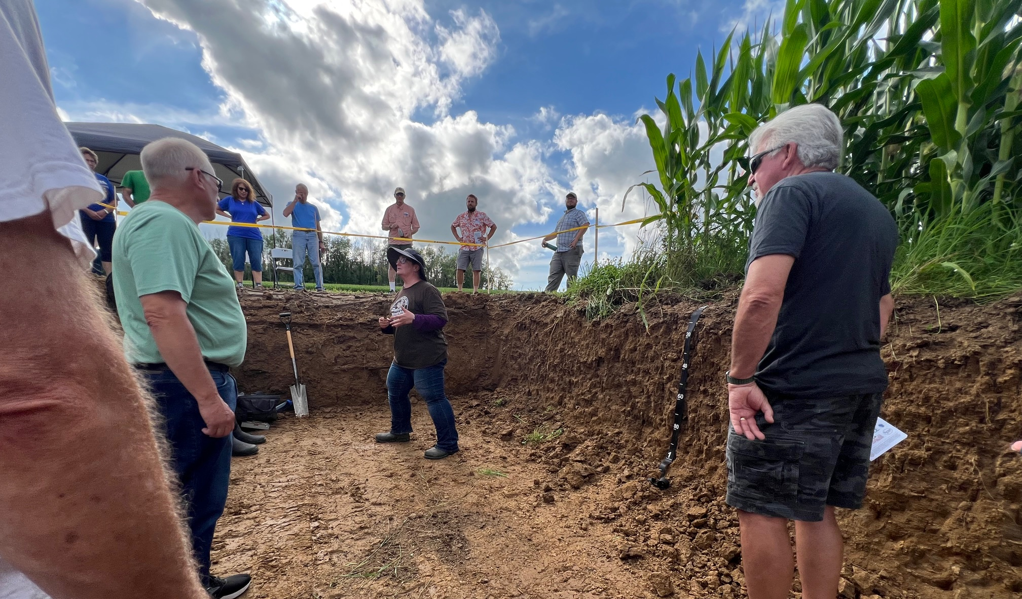
Cover crops are essential for erosion control.
This is a demonstration of soil impaction made by heavy machinery and the depths of various crop root systems.

Slide 7
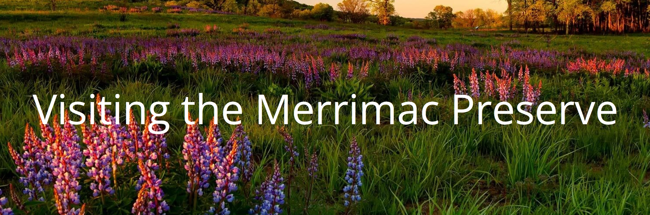
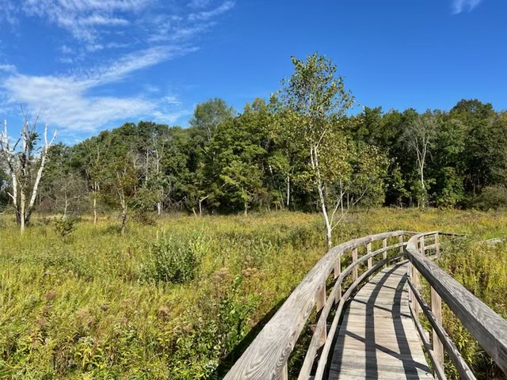
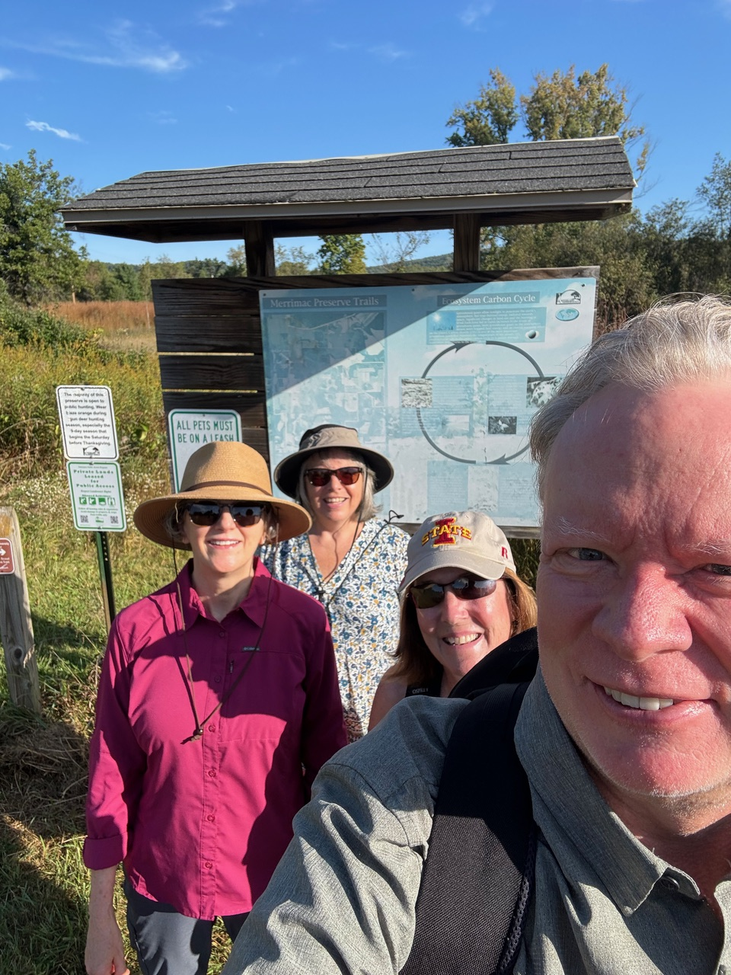
Hiking the Merrimac Preserve to see the Prairie restoration in our watershed.

Slide 8
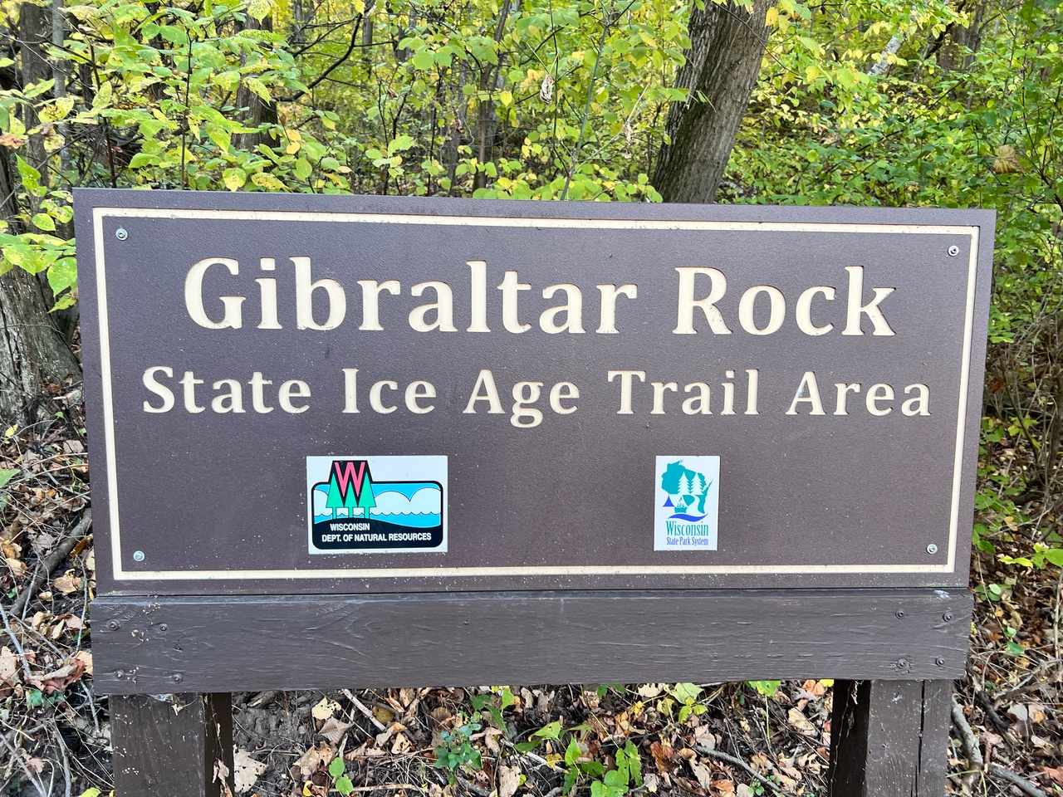
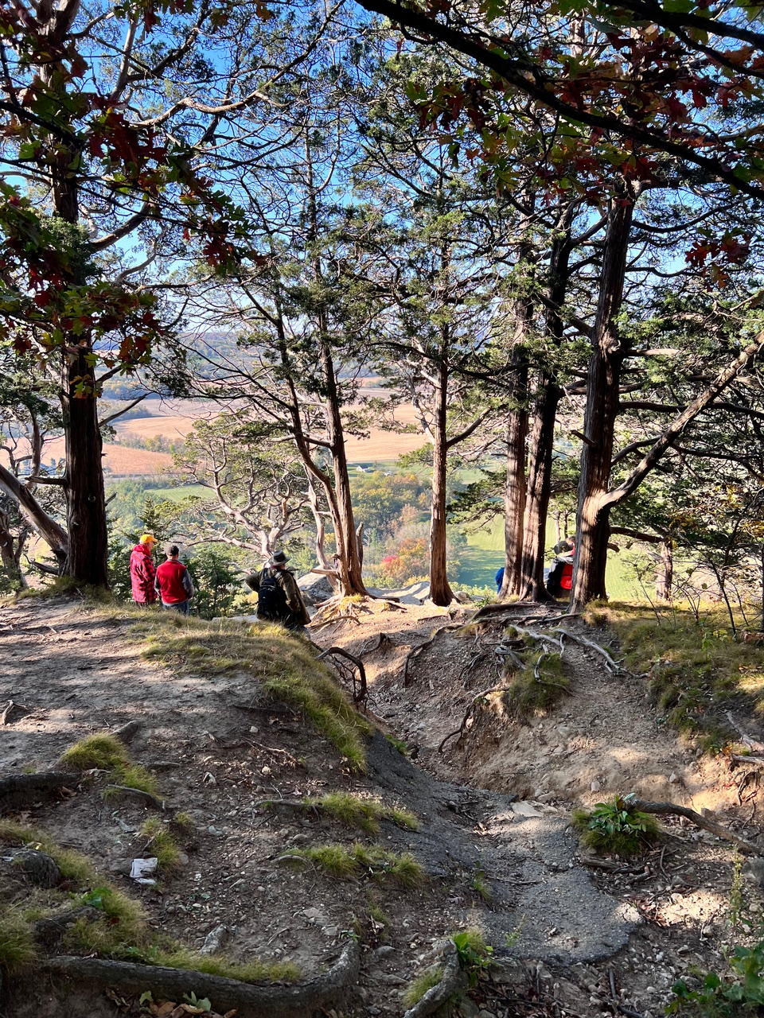
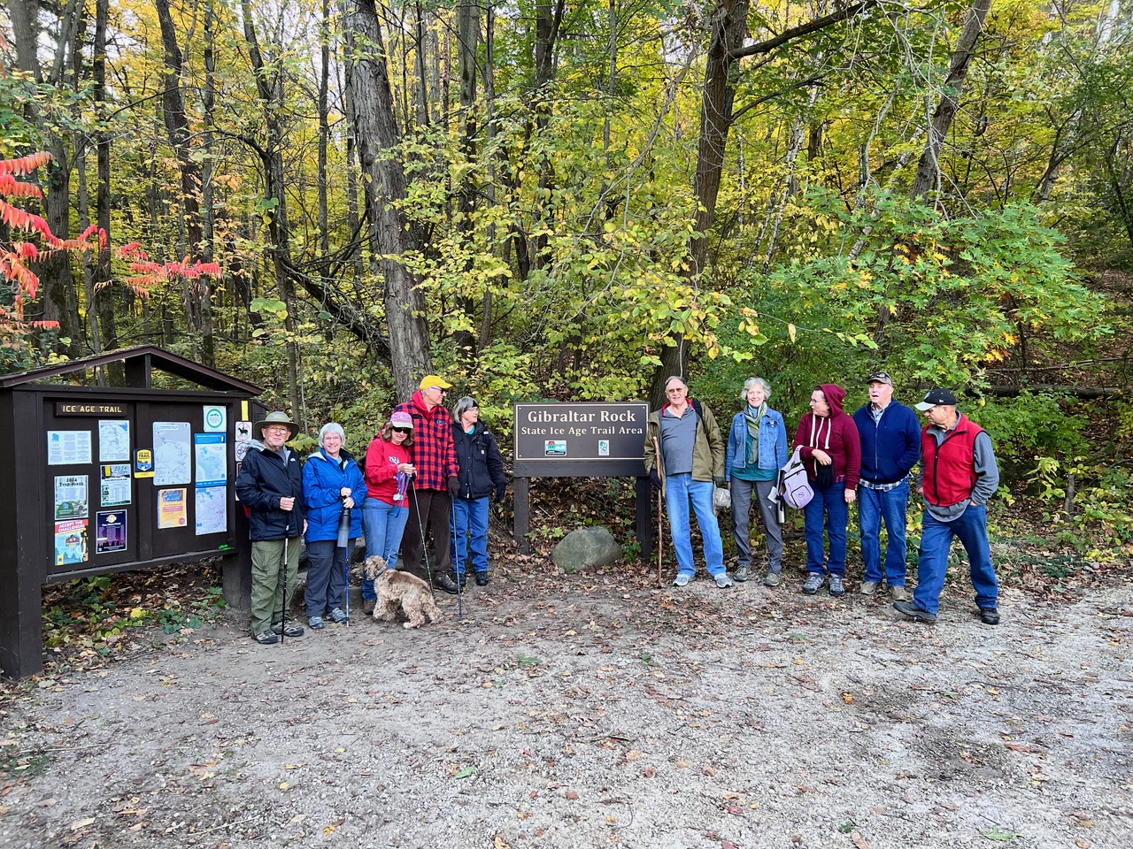
Hiking the Gibraltar Rock trail and seeing the fall colors.

Slide 9
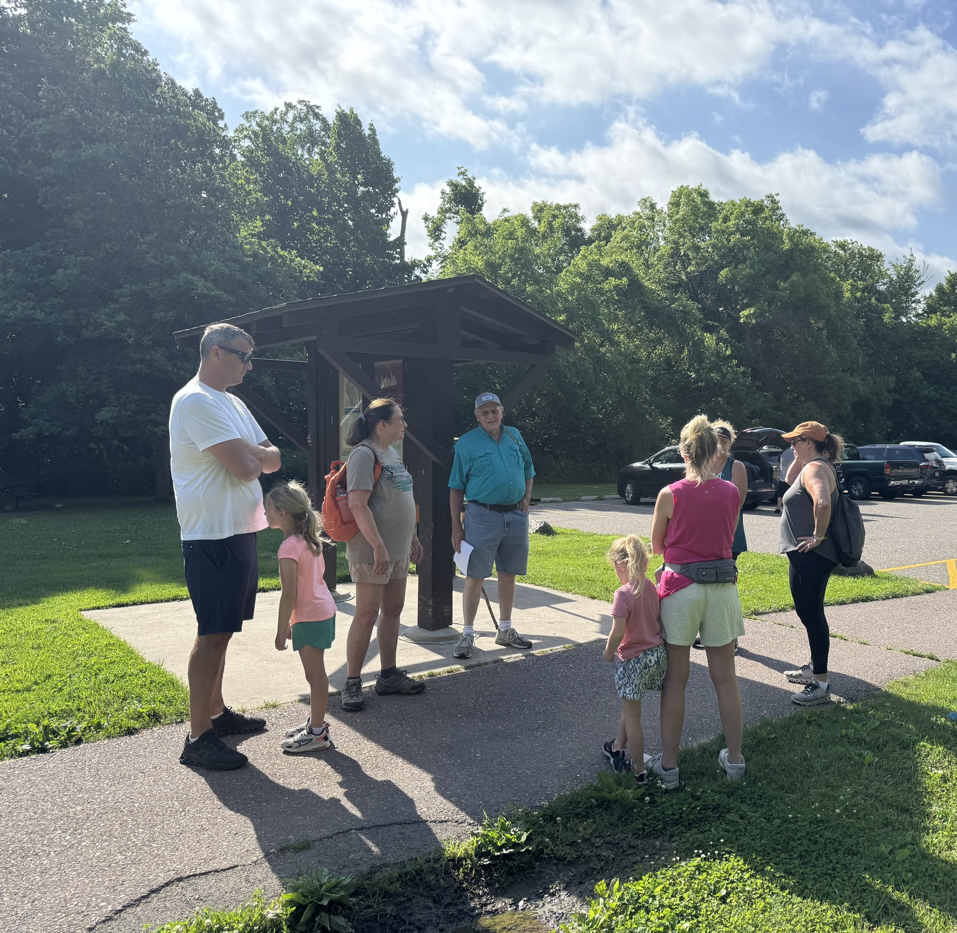
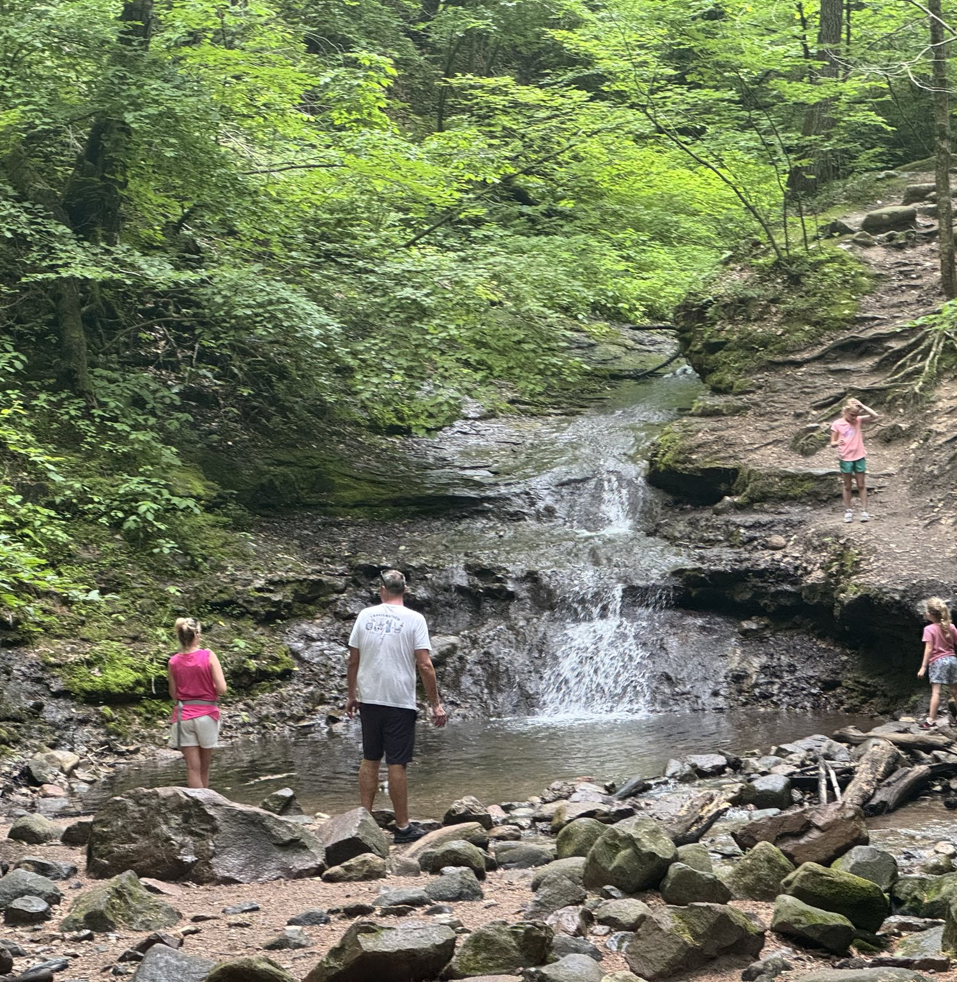
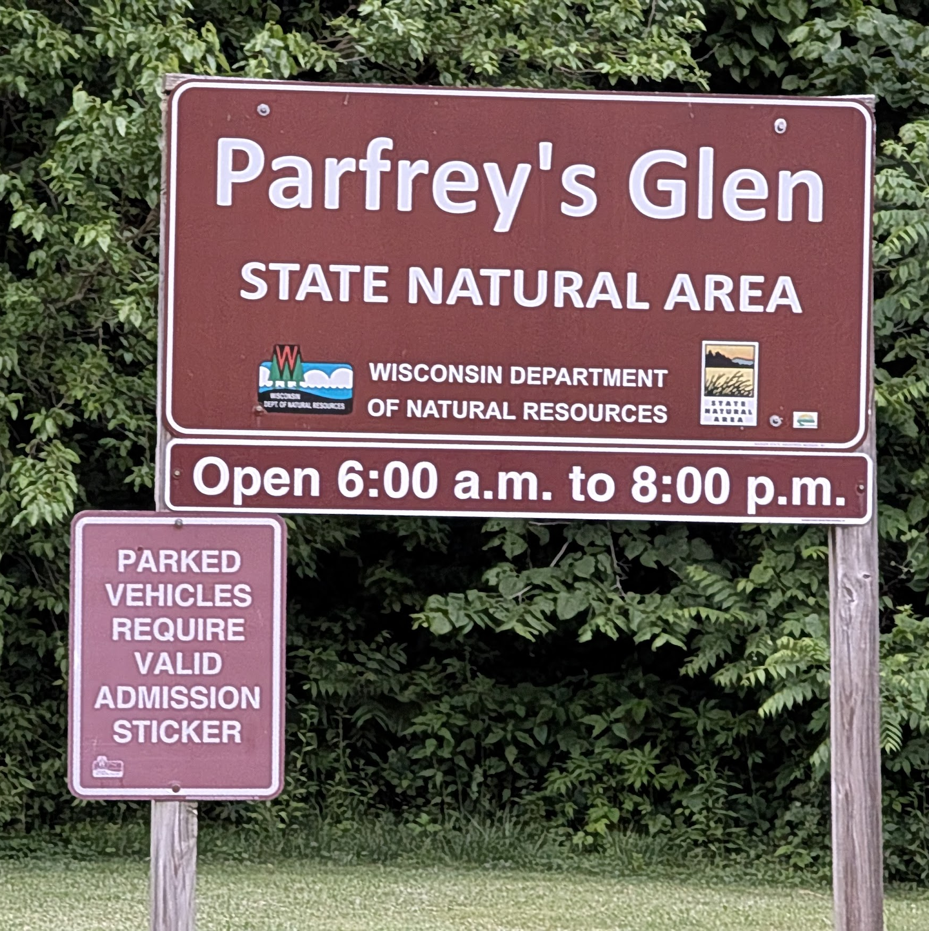

Exploring Parfrey’s Glen
This is one of the first designated Wisconsin State natural area. It is part of our Lake Wisconsin watershed by running through the Gallus Slough in Merrimac Preserve and into our lake at Moon Valley.

Slide 10
Don’t miss out on this year’s Merrimac Preserve hike September 20, 2025 9am and Gibraltar Rock’s trail hike October 18, 2025 9am.

Slide 11
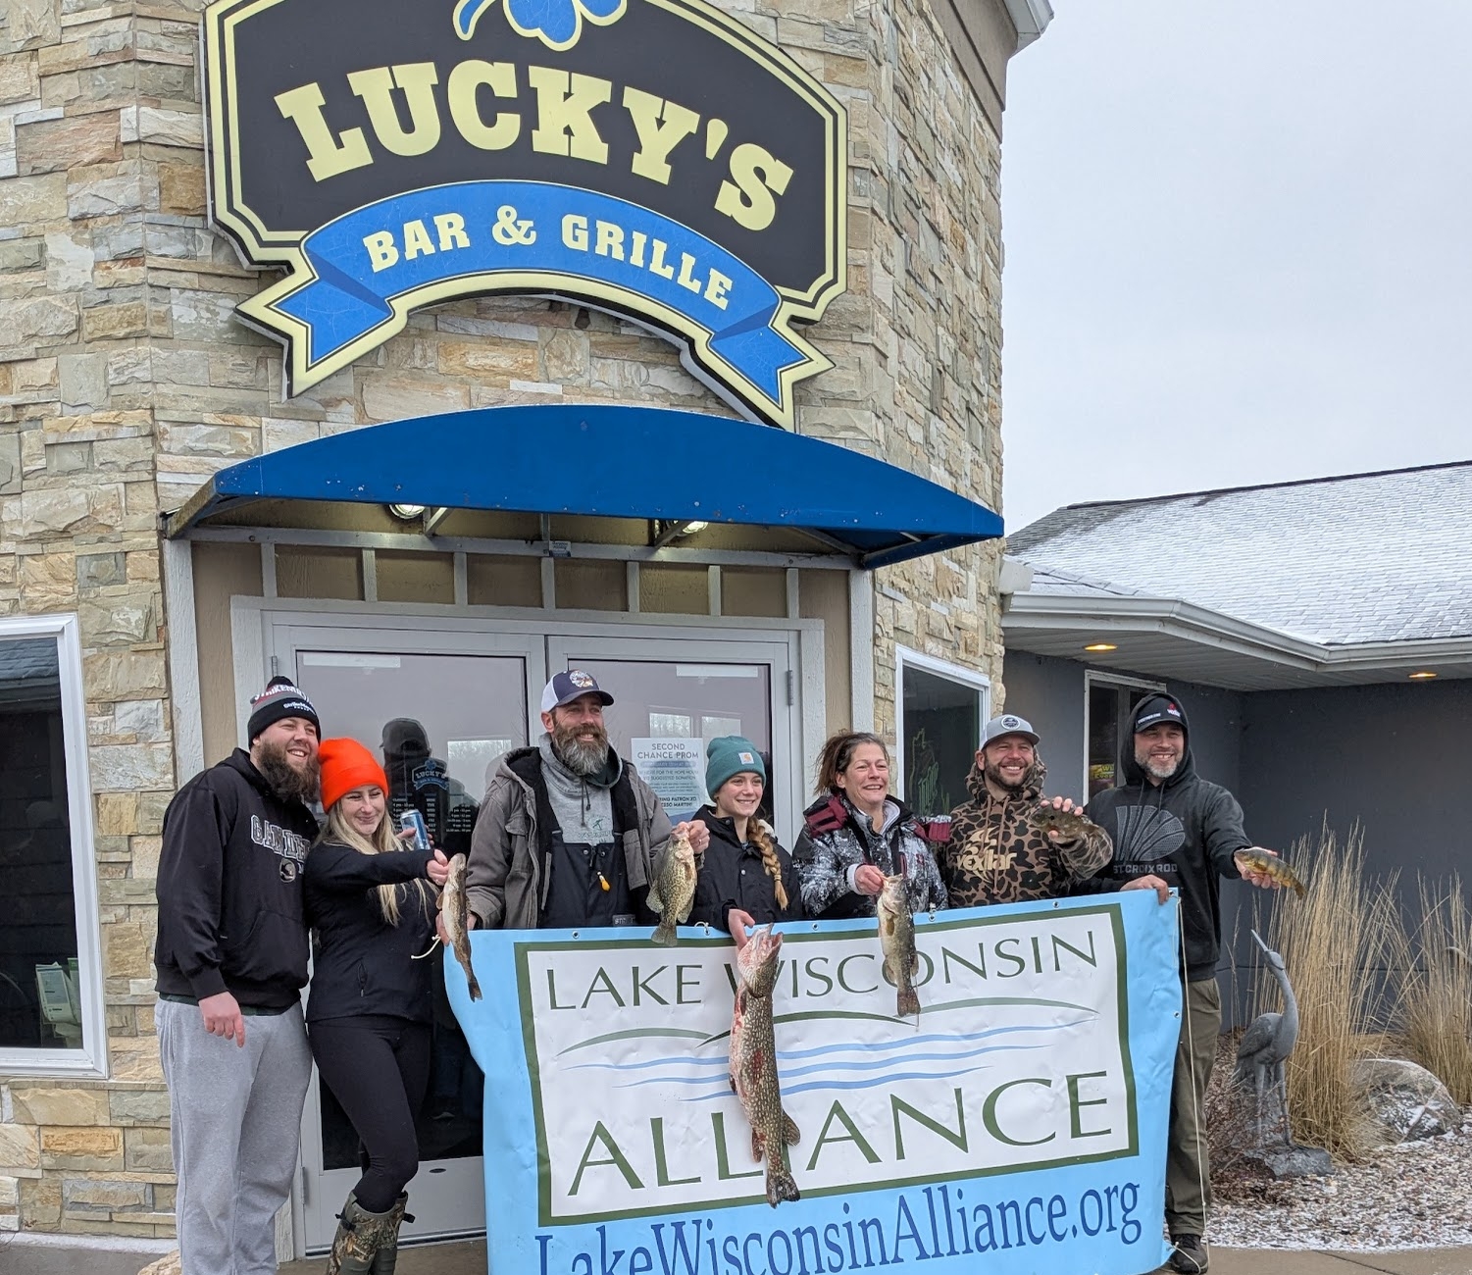
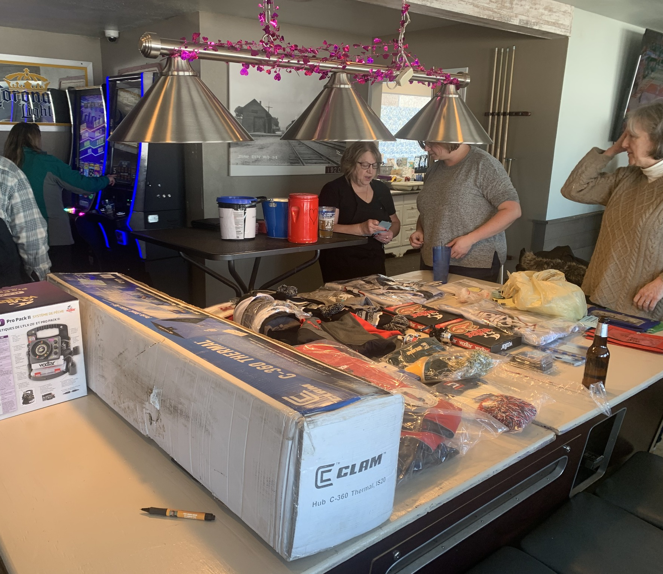
11 Ice fishing tournament with Lucky’s and LWA. This was a fund raiser for us – included fishing and raffles for ice fishing prizes.

Slide 12
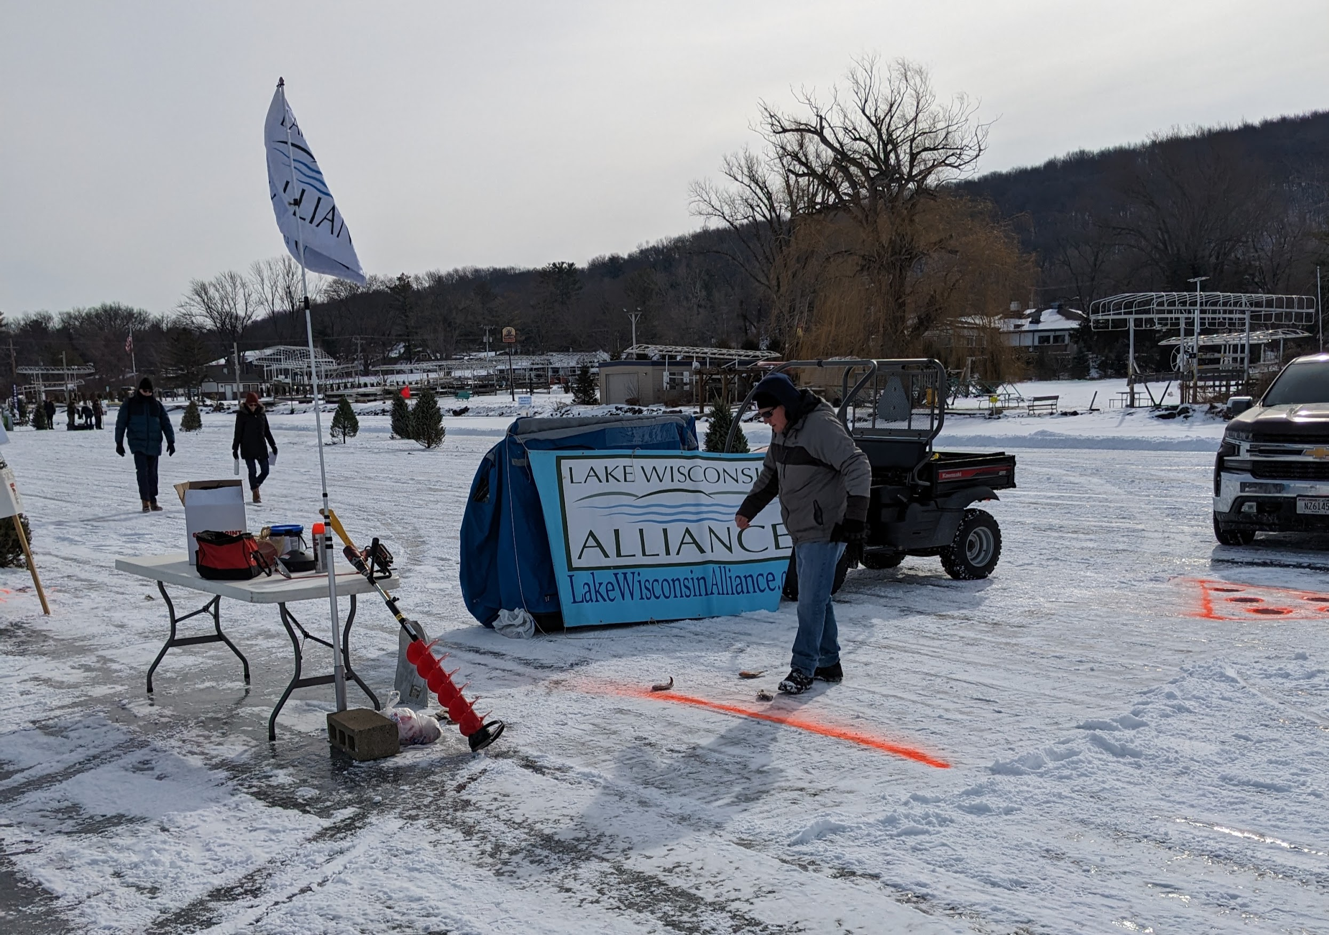
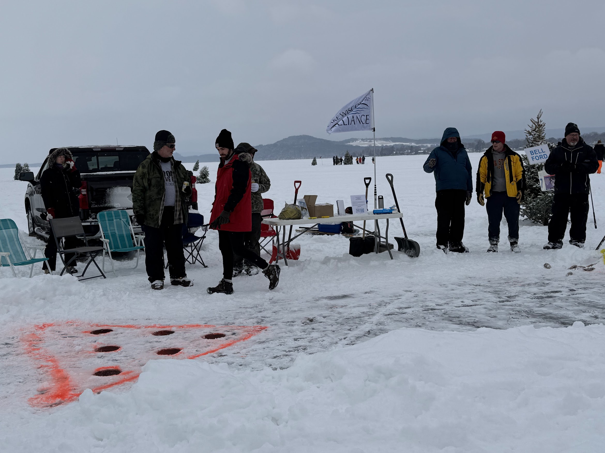
We sponsored a hole for the Lake Wisconsin Lion’s Club Eskimo Open. We had our frozen fish shuffleboard.

Slide 13
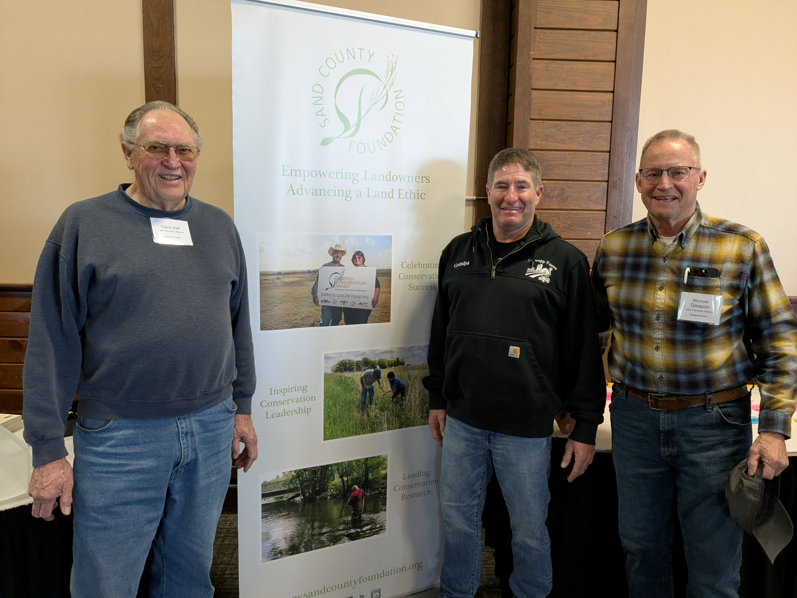
We were invited to present at the Leadership for Midwestern Watersheds: Growing the “Farmer-Led” model at Starved Rock in Illinois. Ron Schoepp invited Mike Gleason and David Kell to share our partnership as an example of the conference theme.

Slide 14
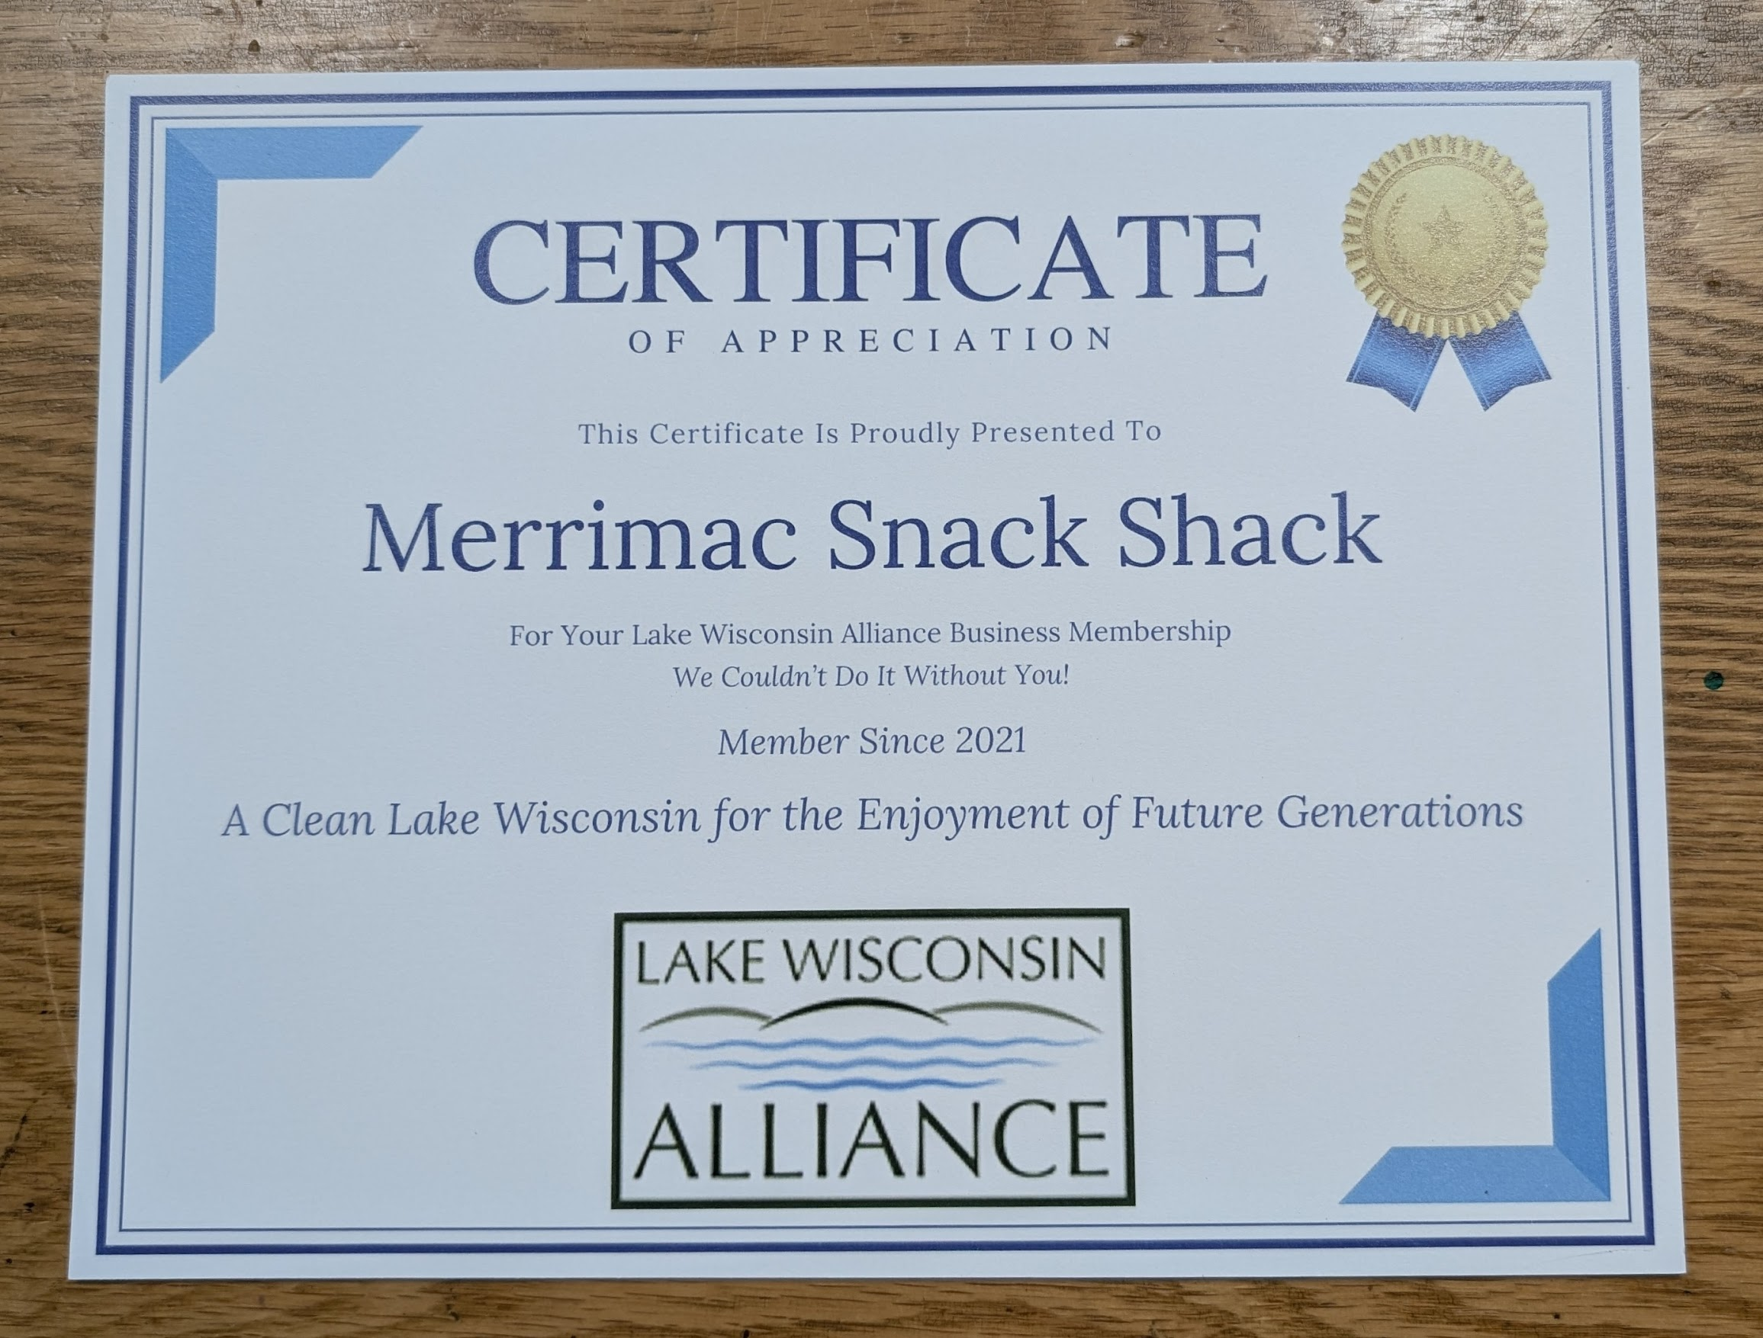
This is a sample of the certificate we gave to more than our 20 business sponsors.

Slide 15
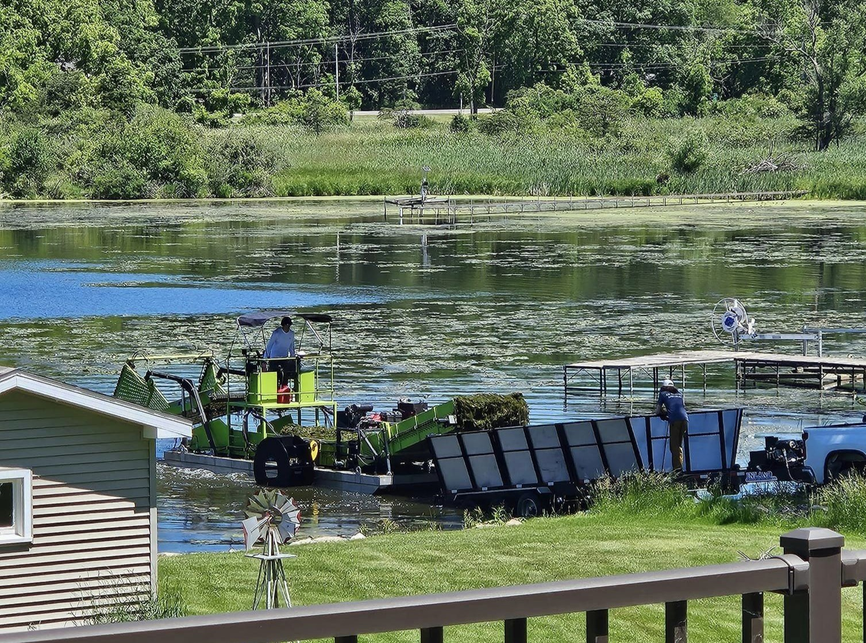
We gave grants to several organizations in our watershed that share our mission goals.
Our grant was for the purpose of sharing the expense for the use of the harvester to remove invasive species. This is for the Okee Bay Lake Association.
The Lake Wisconsin Alliance endeavors to balance the diverse interests of the Lake Wisconsin community while improving water quality, recreational opportunities, and sustaining a healthy ecosystem within the Lake Wisconsin watershed.

Slide 16
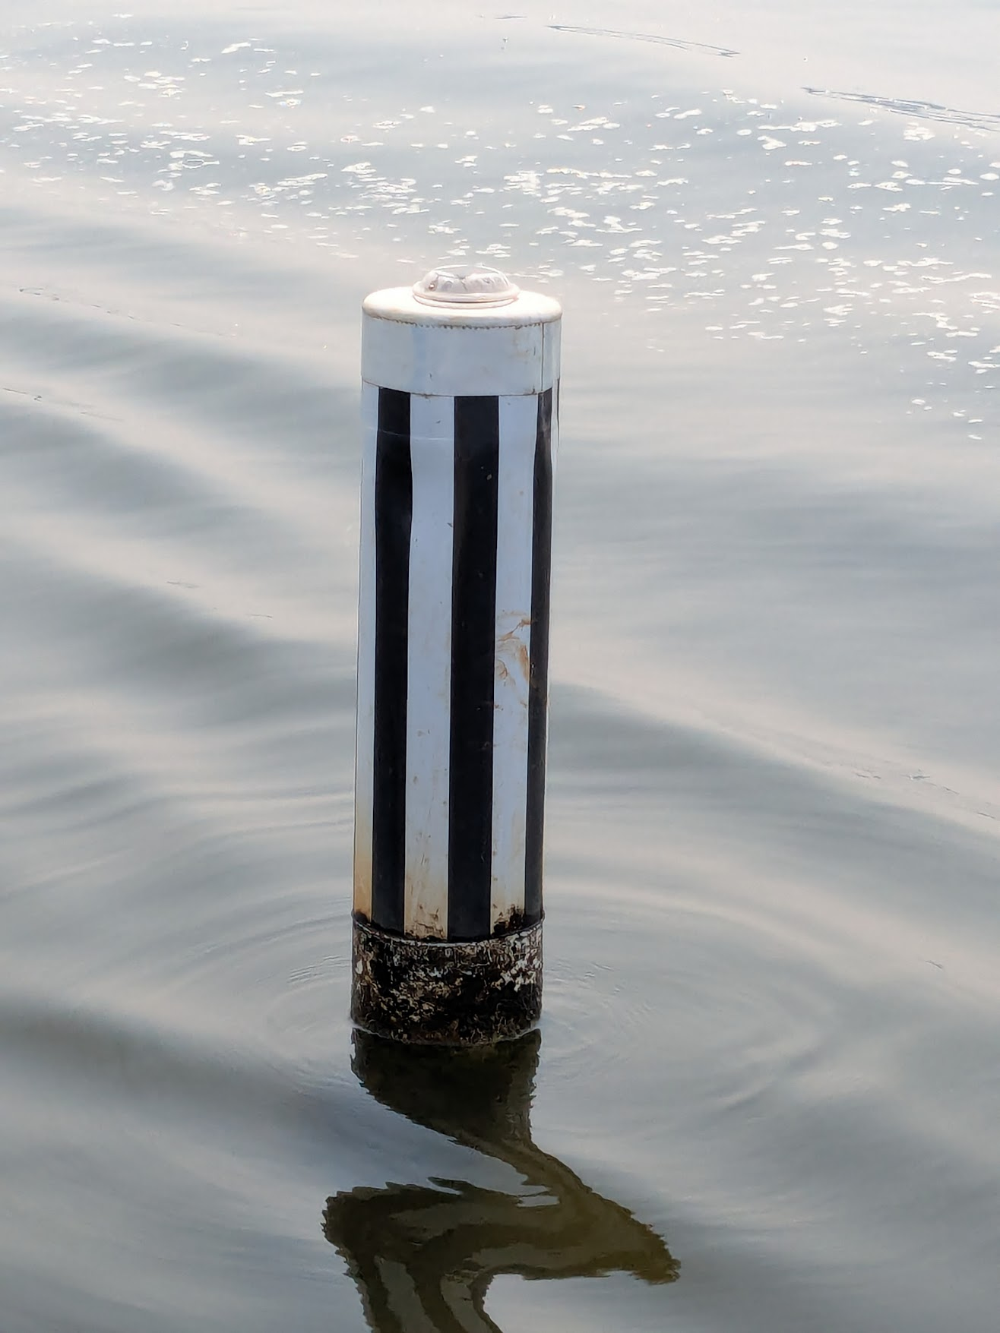
We participated with the Grade Boat Club on their lighted buoy project for the river channel in the river and the lake.

Slide 17
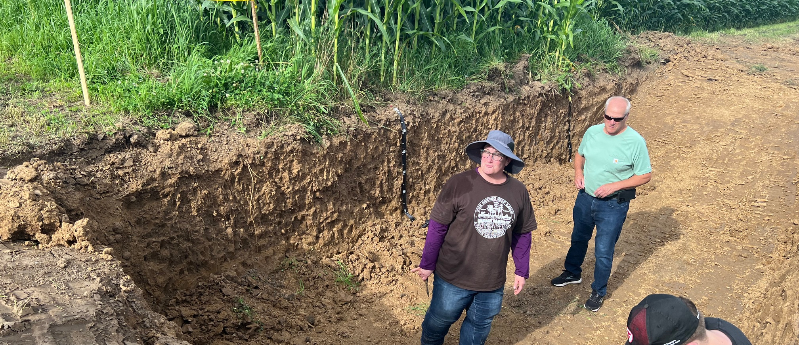
We participated in the Conservation Night by the Lake as well as gave a grant for expenses to Lake Wisconsin Farmers Watershed Council.

Slide 18
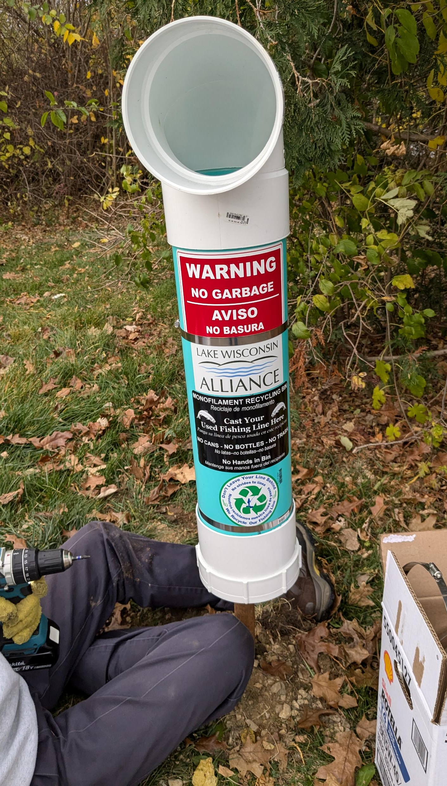
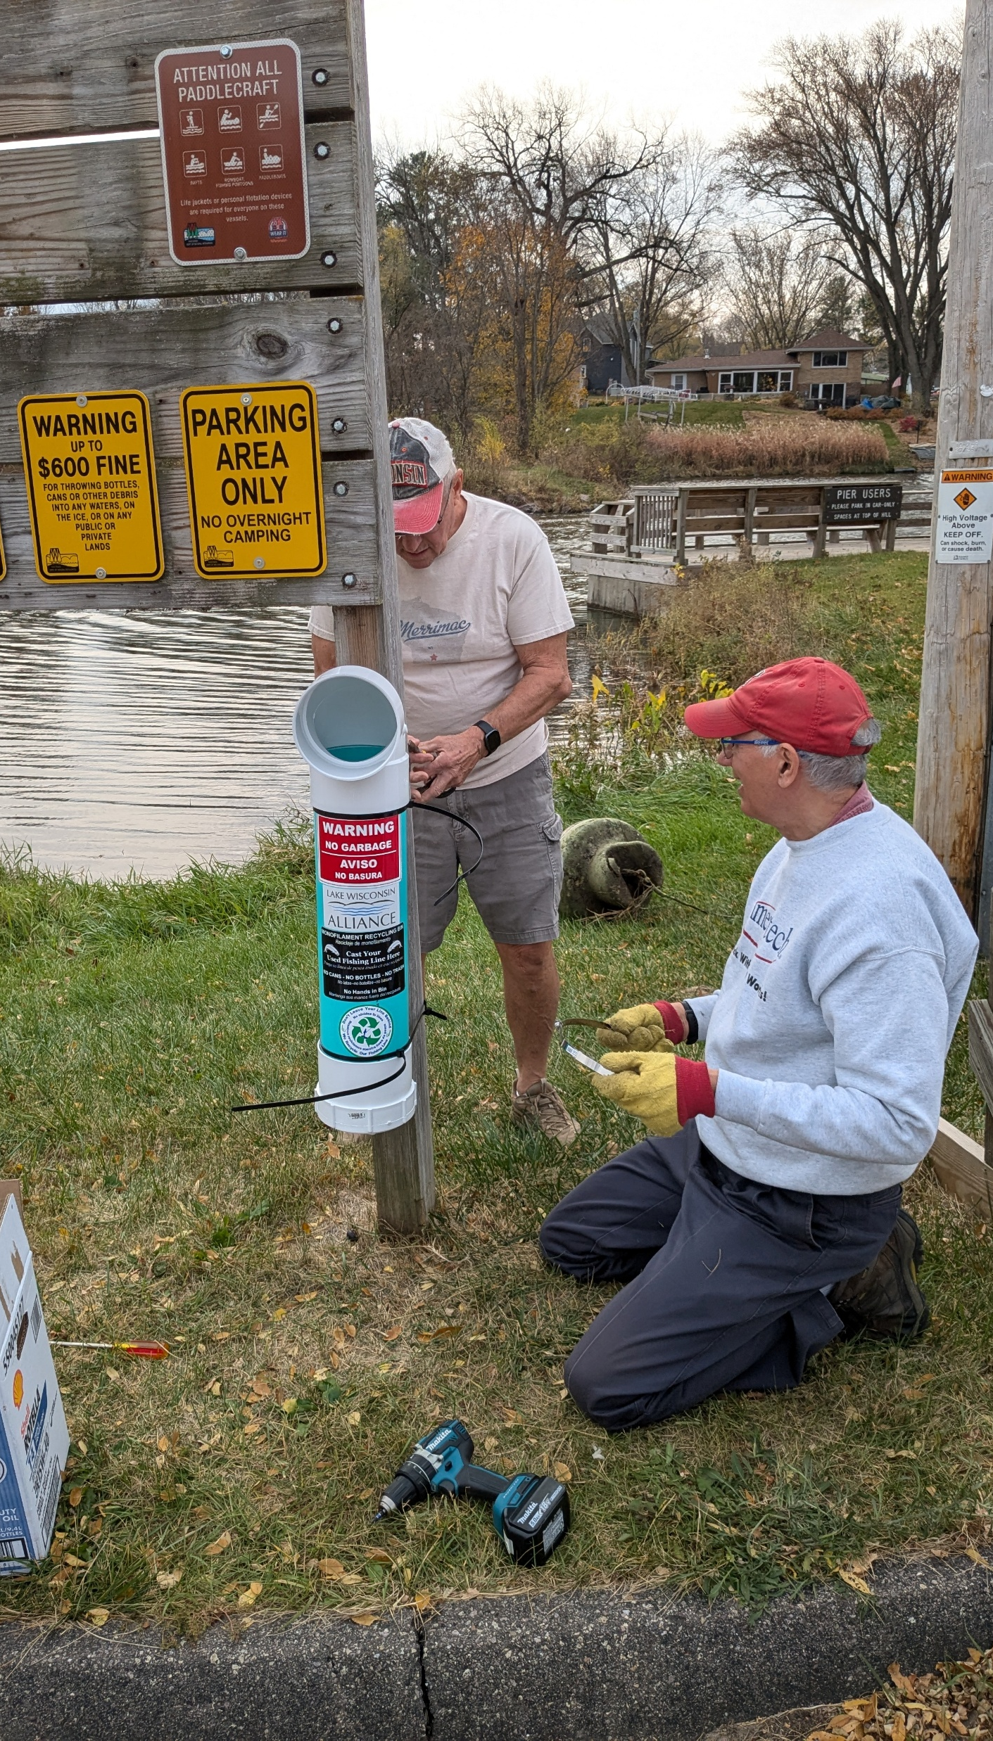
We had a project of recycling monofilament fishing line. 5 tubes were placed at boat launches and parks. One was added to the Burhopp’s Lodge. These were designed and made by our board member Rob Zumm.

Slide 19
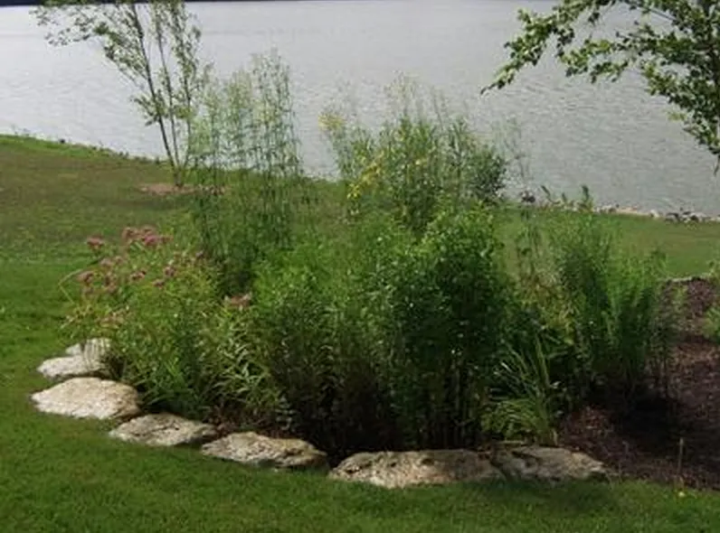
We had a newsletter for the Native Plant Initiative and a newsletter for our LWA association. These will be combining this year.

Slide 20
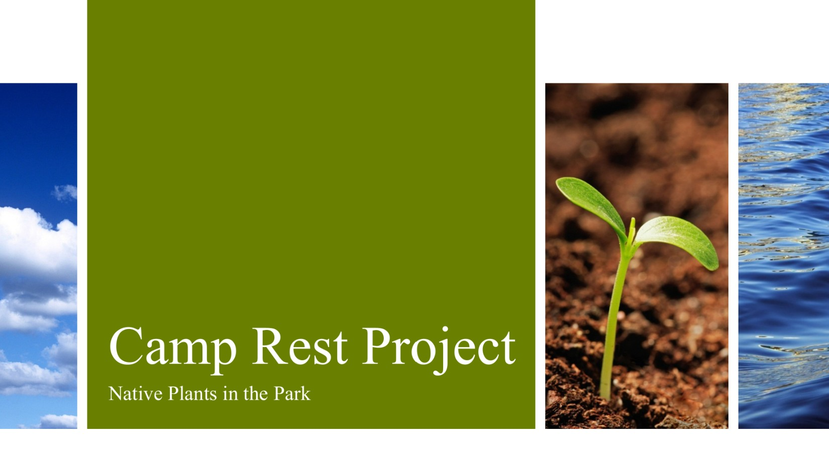
We joined with Dekorra Township to establish native plant gardens at Camp Rest in Dekorra Township on Tipperary road. Watch for this progress as we offer native plants by the lake shore as example for other to learn about.

Slide 21
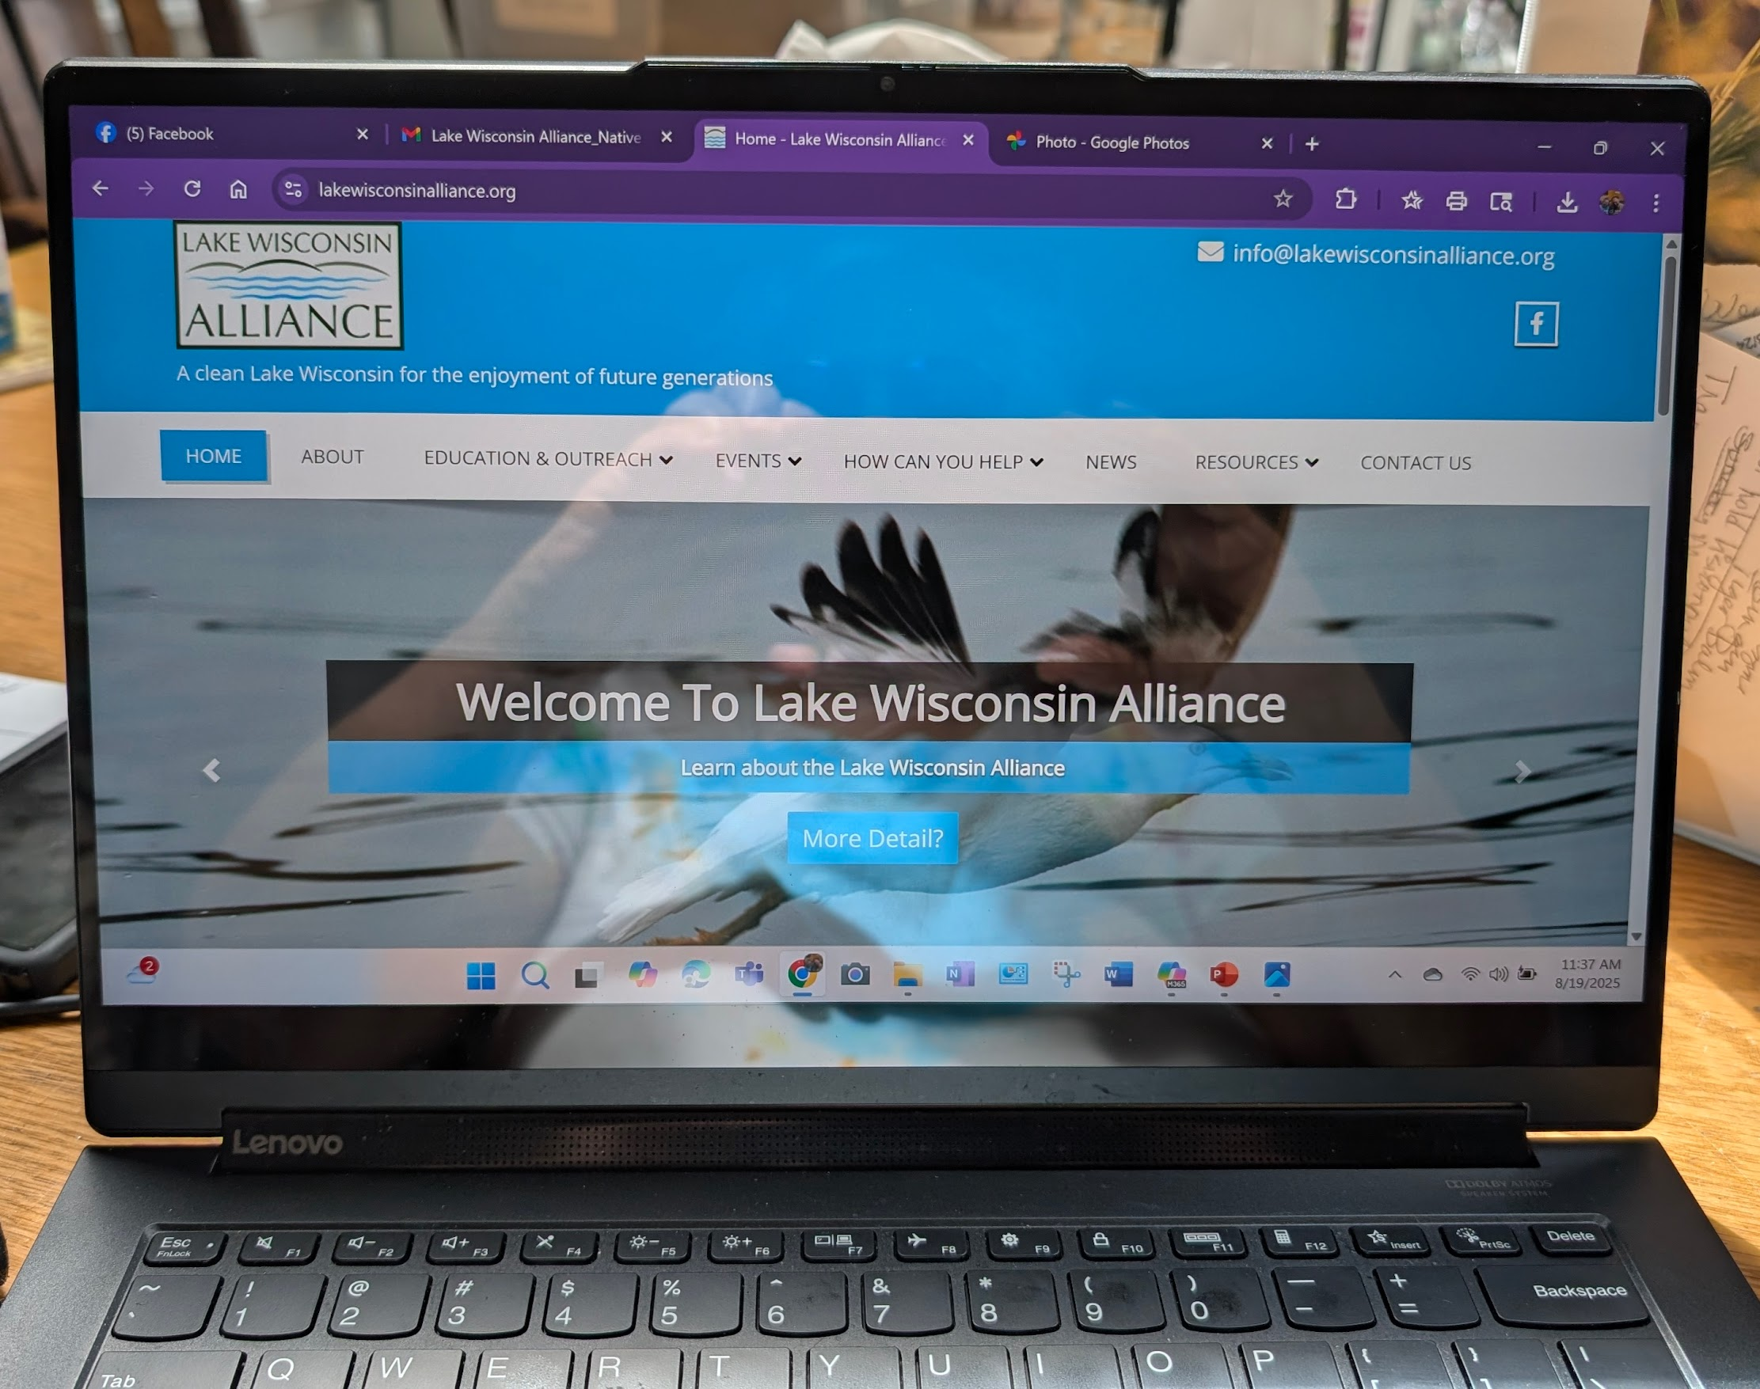
We are in the process of establishing a new website. Watch for updates as they become available.

